Slide 1

COMPASS MARITIME SERVICES LLC : SHIP VALUATION
By:
MANOJ PALUCHURI
ROHITH KOTA
ROSHAN DUBEY
YASHVEER SHRIMAL

Slide 2
INTRODUCTION
We are going to determine how to estimate the price of the capsized ship-Bet Performer, for a client under the current circumstances using mathematical methods.
We begin with a list of recent capesize ship sales and a list of ship attributes that can affect the cost of the ship.
To locate a reference ship from the list, we determined the Manhattan distance. Regression analysis was then used to arrive at the most precise approximation of the bet performer value.

Slide 3
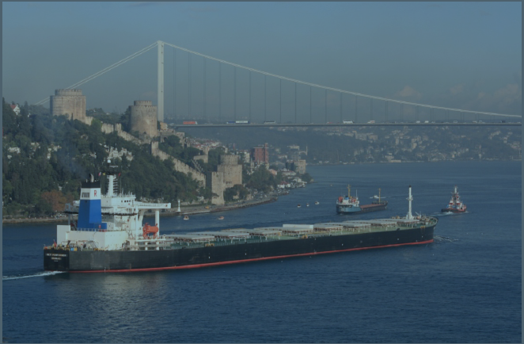
BET PERFORMER ATTRIBUTE DETAILS
Age: 11-years (built in 1997 in Japan by Nihon(NKK))
DWT: 172,000 tons
Engine : Burmeister & Wain (B&W) 6S70MC
Capesize Index: 12,479 (May 2008)

Slide 4
SHIP VALUATION
Year built
Age at sale
Size ( Dead Weight Ton)
.
Market Approach
Factors that affect the Ship price
Find price of ship based on comparable recent transactions in the market
External factors:
Capesize(Current market & economic conditions)
Engine specifications and its capacity
Current location
Builder and production quality

Slide 5
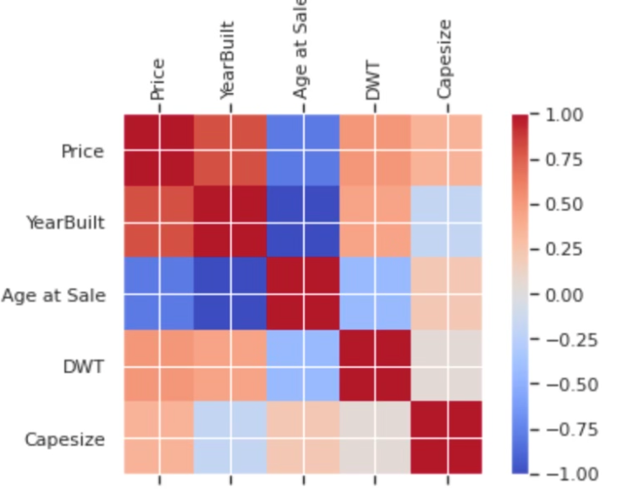
RELATION BETWEEN VARIABLES
Single Variable Analysis Against Sale Price (y) | Age of sale (x1) | DWT (x2) | Capesize (x3)
Intercept | 133.12 | -84.16 | 36.43
Correlation | -0.78 | 0.51 | 0.35
Standard Error | 7.58 | 38.81 | 15.03
Coefficient | -4.21 | 0.98 | 0.0048
R-Square | 0.62 | 0.26 | 0.12
Adjusted R-Square | 0.61 | 0.24 | 0.105
Sale Price (without error) | 86.74 | 85.87 | 96.33

Slide 6
COMPARABLE SHIPS
In order to find the best comparable ship to the Bet Performer, we used the following approaches
We identified the closest ship based on comparable transactions using Manhattan distance
After that we applied linear regression on single and multiple variable to identify which characteristics of the ship effects the price of the ship

Slide 7
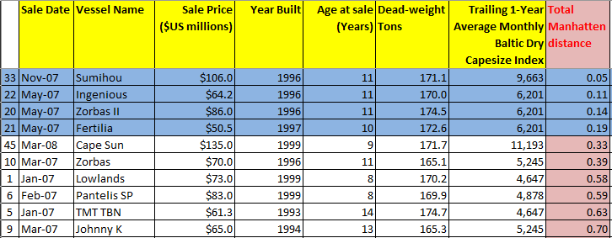
COMPARABLE SHIPS (MANHATTAN DISTANCE)
We have calculated Manhattan distance using the main attributes (internal factors) of the ship
Age of sale
Dead-weight tons
Sumihou is the closest approximation for our ship from Manhattan distance (from Exhibit 1)
Exhibit 1

Slide 8
MANHATTAN DISTANCE
The capesize is a non-ship-related external feature that influences the sale price. It is based on trade routes and trade values for the coal, iron ore on any particular day.
From January 2007 to May 2008, we saw that Capesize increased every month and remained constant for the entire month, regardless of the age or DWT of the ship at that time.
We tried to assess the impact of capesize on sale price, however the data we had was bit limited and prevented us from providing an accurate estimate.

Slide 9
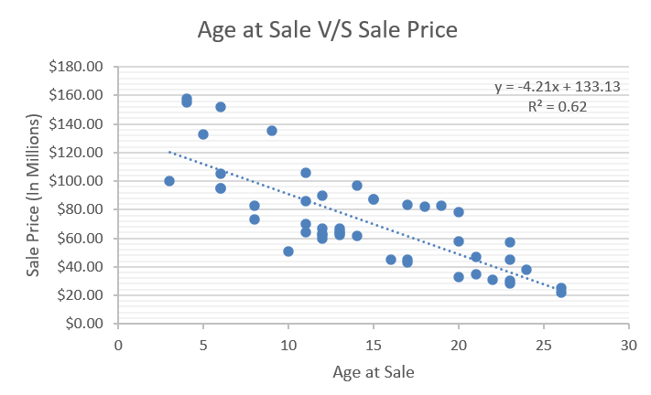
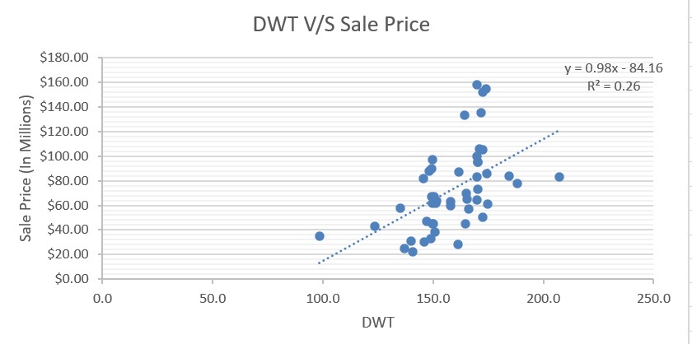
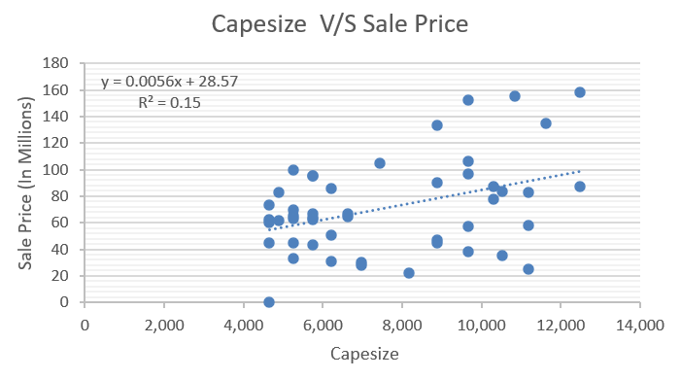
SINGLE VARIABLE LINEAR REGRESSION METHOD
By analyzing sale price individually with Age at sale, DWT and Capesize, we get the following results
Age at Sale : Ships value depreciates around $4.2 million each year as the ship ages.
DWT : For every one unit increase in DWT, the price of the ship increases by $0.98M.
Capesize : For every one unit increase in Capesize, the price of the ship increases by $0.004M.

Slide 10
MULTI VARIABLE REGRESSION ANALYSIS
After single regression model, we tested how the ship price would get affected if all the attributes of the ships are considered at once using a multiple regression analysis.
By analyzing sale price with Age at sale, DWT and Capesize jointly, we get say that 92% of the variation in sale price can be explained by these three attributes

Slide 11
PRICE PREDICTIONS FROM REGRESSION MODEL
Attribute Variable | Constant | Equation to calculate price
Age | DWT, Capesize | Price = -4.21(Age) + 133.13
DWT | Age, Capesize | Price = 0.98(DWT) - 84.16
Capesize | DWT, Age | Price = 0.0056(Capesize) + 28.57
Age, DWT, Capesize | - | Price = 44.22+ (-4.21(Age)+ 0.24(DWT)+0.007*(Capesize))

Slide 12
WHAT IF
Condition | Input Variables | Price (In Million USD)
Ship was 5 year younger | Age = 6, DWT = 172, Capesize = 12479 | $148.55
20K DWT Lighter | Age = 11, DWT = 152, Capesize = 12479 | $120.98
Charter rate were 30% lower | Age = 11, DWT = 172, Capesize = 8735 | $ 98.84

Slide 13
EXTERNAL FACTORS AFFECTING PRICE
Current condition of the ship
Location of the ship at time of sale
Capesize at the time of sale
Market scenario at the time of sale
Loan rates at the time of transaction

Slide 14
PRICE RECOMMENDATION AND OTHER SUGGESTIONS
Based on our analysis, we believe the estimated price of the ship should be $125.75 Million with a standard error of +/- $9 Million.
However, the client should check factors like Ship Maintenance (body and engine), Ship’s current location, capesize of the ship at the moment of transaction, market dynamics at the time of transaction, cost to repair broken parts, port charges.
Considering our external factors mentioned above, our final price is $137 Million
Since the shipping industry is extremely volatile, we would suggest the client to sell the ship once again in a short span of time if the market at that time supports.
On the other hand, if the market falls and the ship prices go down, we would suggest the client to scrape the ship and sell individual parts, as in some markets, this approach might earn more

Slide 15
Thank You

